Slide 1

Stress Detector “We are with you...”

Slide 2

We believe we are creating a product to solve a unseen problem...

Slide 3
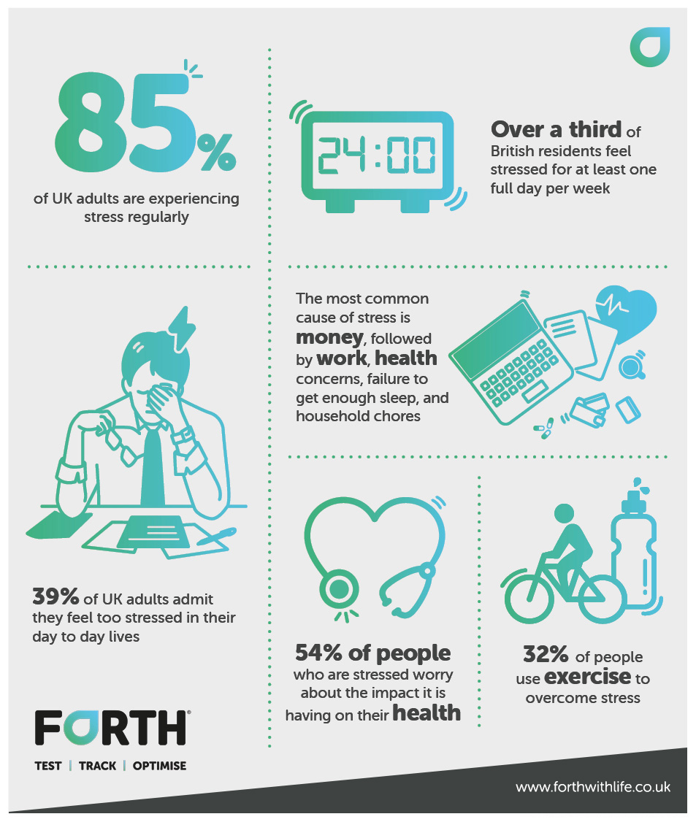
ISSUES WE ARE TRYING TO SOLVE
High absenteeism
Poor performance and productivity
Emotional problems (depression, anxiety, anger, grief, guilt, low self-esteem)

Slide 4
STRESS DETECTOR
We can detect stress through any camera using our software.
Guide the employer/concerned person about the levels.
We can provide solutions and advises to the person who is in the urgent need of help.
Calculate stress level of the organisation.

Slide 5
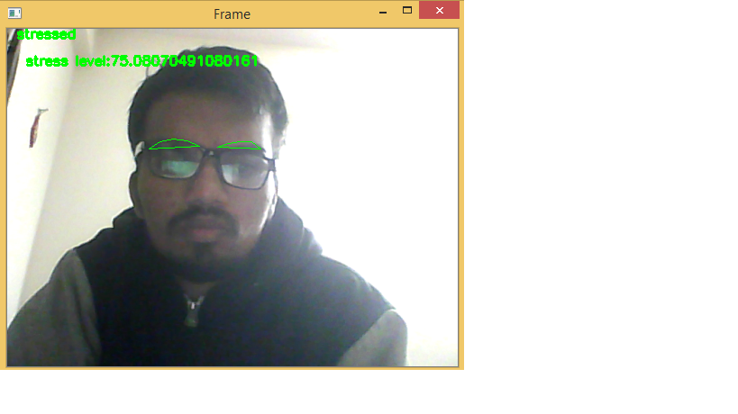
Basic prototype

Slide 6
SOLUTIONS TO THIS PROBLEMS..
Meditation
Exercises
Music
Yoga
Getting help from Psychiatrist.

Slide 7
Questions ??

Slide 8
Thank you

